Slide 1

How Olist can be “Data-Driven”

Slide 2






Our Team
Muhammad Bilal Jamil
Surbhi Nayak
Humayra Kausar
Daniel Strauss

Slide 3
Olist at a Glance
Olist, a Brazilian e-commerce platform founded in 2015, connects small businesses to larger product marketplaces to help entrepreneurs sell their products to a larger customer base. Olist connects entrepreneurs with major online retailers and allows shopkeepers to advertise and sell in the marketplaces without complication, enabling retail companies to reach out to the international marketplaces, improve the shopping experience and modify their purchasing behavior. Through a single, seamless integration, Olist provides full stack operational support to merchants by managing product catalogues, inventory, pricing, fulfillment, customer service, and payments in a single place

Slide 4
Problem statement:
How Olist can better serve their customers and help businesses to increase their e-commerce platform presence to reach out to the larger customer base as well as heighten their market share through data driven approach
Solution:
Collect customer data from various sources to understand customers purchasing behavior.
Build AI model to predict customers purchasing pattern and to understand their needs and desires which will leads to serve them better, maintain current customer base, upsell to current customer base, increase market penetration, and create brand addiction.
Based on customer purchasing pattern and behavior we will provide tailor solutions to the businesses to heighten their online marketplace presence to reach out to the larger customer base and drive business growth.

Slide 5
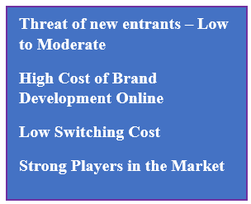
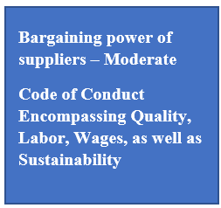
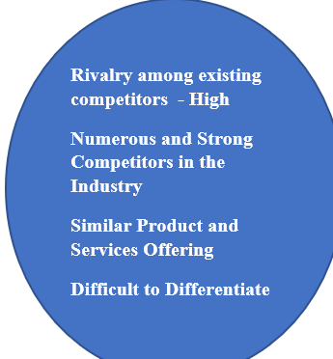
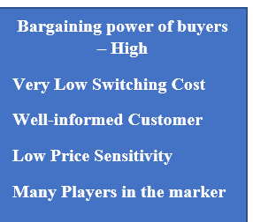
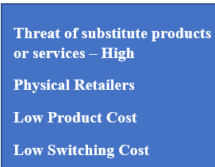
Porter’s Five Competitive Forces model.
The figure exhibits how the five competitive forces apply to Olist and the E-Commerce industry

Slide 6
Olist’s Competitive Stance
Due to the intense competition in the industry, and the high level threat of competitors and substitutes, Olist must prioritize strategies to ensure long - term competence and success.

Slide 7
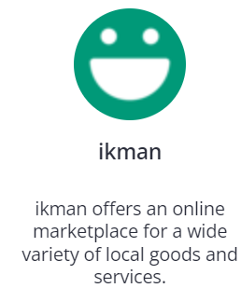
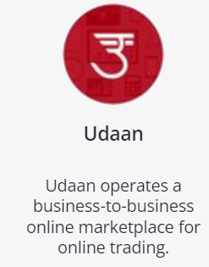
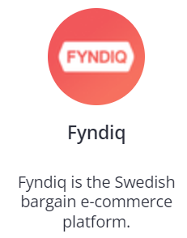
Competitors

Slide 8
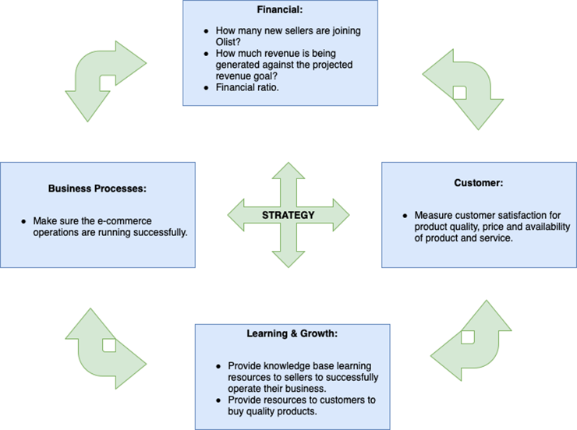
Balanced Scorecard

Slide 9
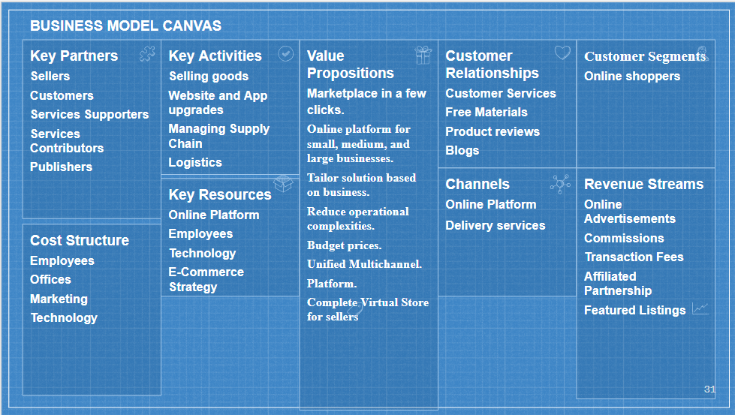
Business Model Canvas

Slide 10
Recommended OKRs
Objective : On-time product delivery
Key Result: Find out the issues associated with on-time delivery and resolve it
Objective: Attract businesses to sell their product in Olist’s platform
Key Result : Reach out to the business personally and explain how Olist can add value to their business
Objective: Helping customers to choose the right product
Key Result : Encourage customer to write reviews, encourage businesses to provide testimonials, and provide product details as much as possible such as details pictures

Slide 11
Recommended OKRs Cont…
Objective : Improving Customer Satisfaction
Key Result : Ensure to collect 100% customer feedback
Key Result : Increase positive feedback and decrease negative feedback by 10% by end of next quarter.
Objective: Ensure installment paid in timely fashion
Key Result : Find out the issues associated with the installment payment, reach out to customers, and solve it.

Slide 12

Team Chart
Summary of roles and responsibilities required to achieve the strategy within the organization
CTO (Chief Technology Officer)
Data Analyst
Data Engineer
Data Scientist
Data Stewards
VP Sales
Marketing Manager
Digital Marketing Analyst
Operations Manager

Slide 13

Persona Seller
Eli Rogers is a trying to become a profitable seller. She is looking too determine which products sell the best for each of her future competitors. She is trying to determine what are the most profitable items sold. So that she knows what items too begin selling. Allowing her to invest her time competing only for the most profitable items. She is a 23 years old Single women. She is hard working but lacks experience.

Slide 14
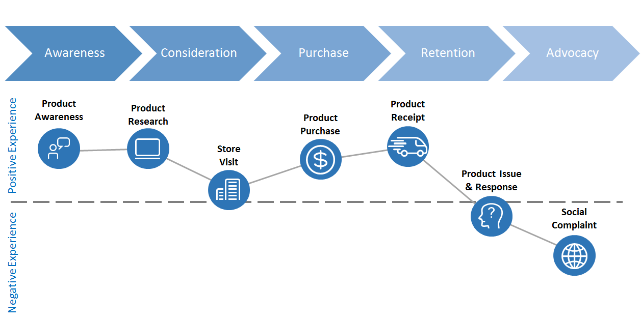
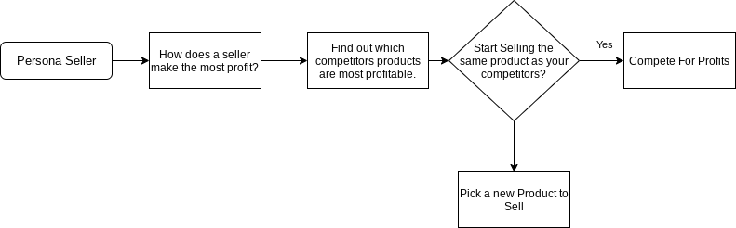
Journey Map Seller
Needs to select the most profitable items to sell
Considers reviews, orders, customers, payments and other variables
Determine what factors contributes to making an item profitable
Determine which items are most profitable
Start Selling

Slide 15

Persona Customer
James Cutter is trying to look for a birthday present for his teenage daughter. He is looking for an inexpensive item that has good reviews, and reliable sellers associated with it. He is 49 years old.

Slide 16
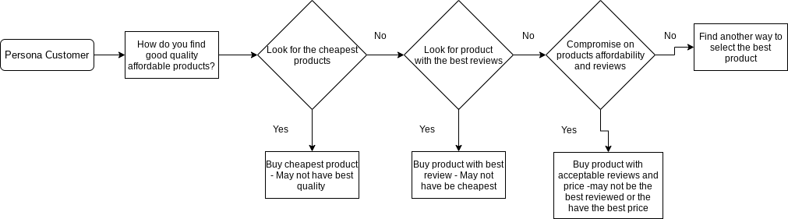
Journey Map Customer
Consider which inexpensive items have the best reviews
Look for inexpensive Items
Confirm that the sellers are reliable
Find the order_item_ID
Purchase the item

Slide 17
AI Use Case
Persona Seller - Do predictions on customer purchases. Look at the products sold, number of products sold, and the overall amount earned by each product. This could potentially be used to inform predictions for future earnings for each product sold by sellers.
Persona Customers - Predict which Sellers will offer the best deals. We want low prices and good reviews. We need to find out which sellers will have the best prices in the future. Likewise we can inform predictions on which seller locations have the best pricing.
Unstructured Learning - Perform unstructured learning to label customers and try to separate them by purchases into different classes. Such as age, gender, the idea is to group people who buy similar products.

Slide 18


Dimensional Model
Created OLTP and OLAP databases in PostgreSQL from scratch.
Generated a data model by connecting DBeaver with PostgreSQL.

Slide 19
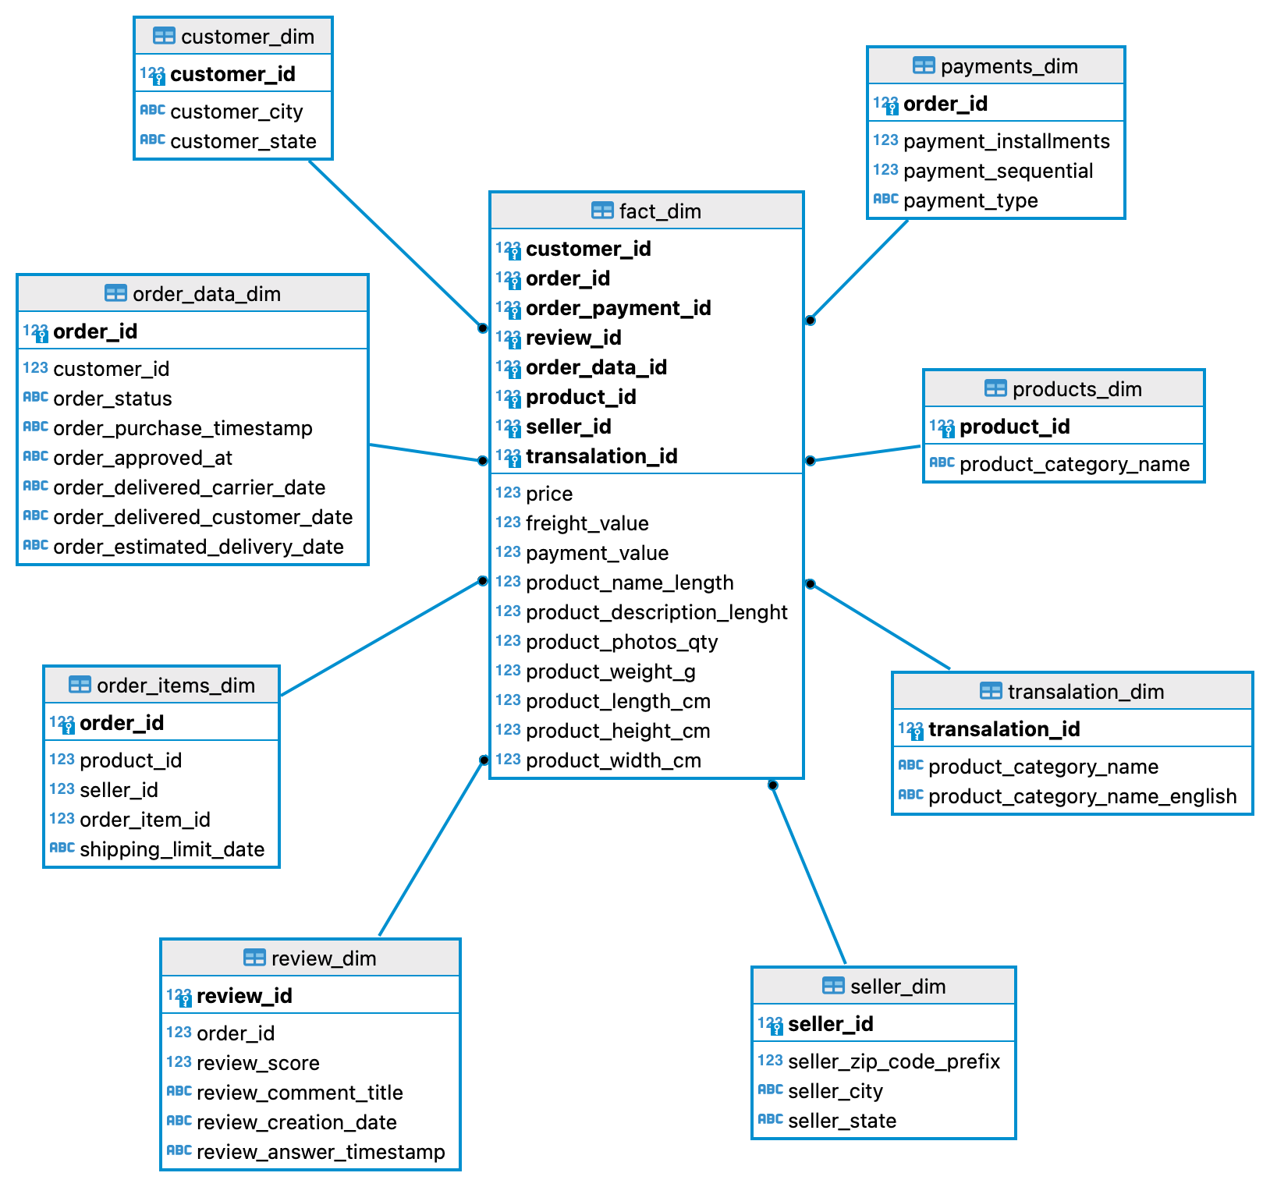
Dimensional Model …. CONT

Slide 20
Dimensional Model …. CONT
Dimensions:
Customer (City, State)
Order data
Review data
Product data
Payments data
Seller data
Shipping data
Measures:
Price
Freight_value
Payment_value
Product_name_length
Product_description_length
Product_photo_qty
Product_weight_g
Product Length, Width, Height

Slide 21
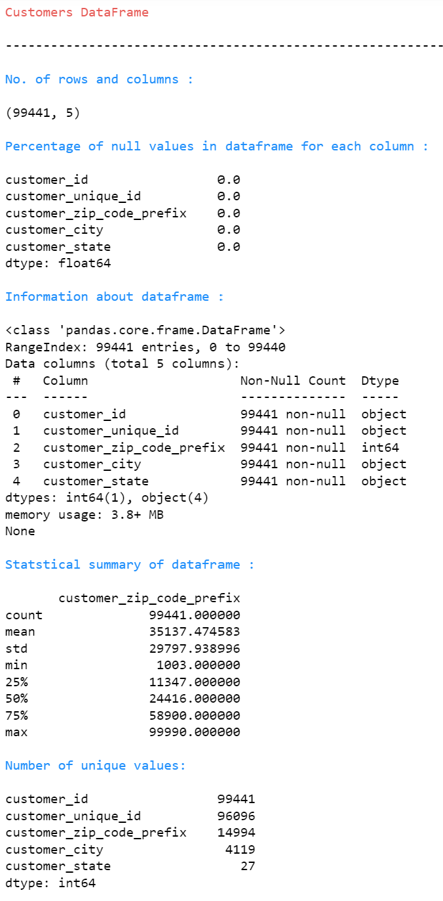
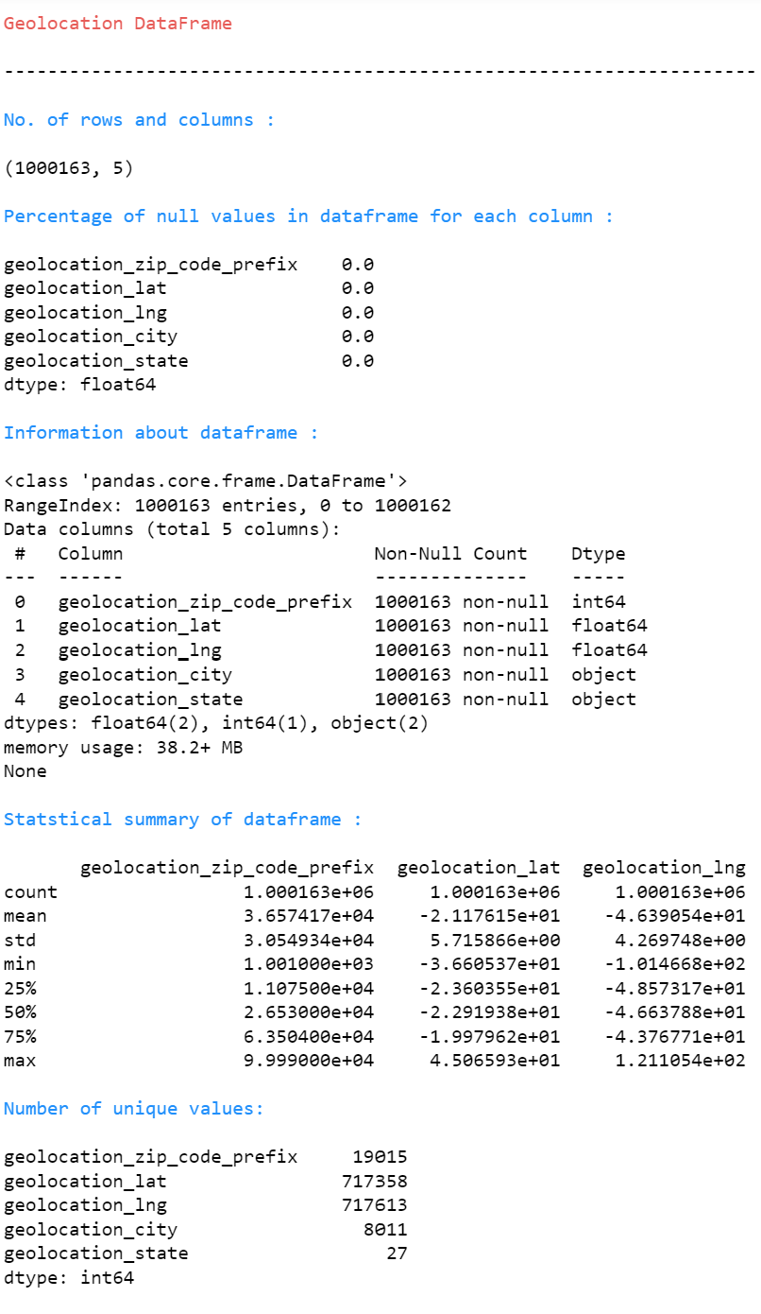
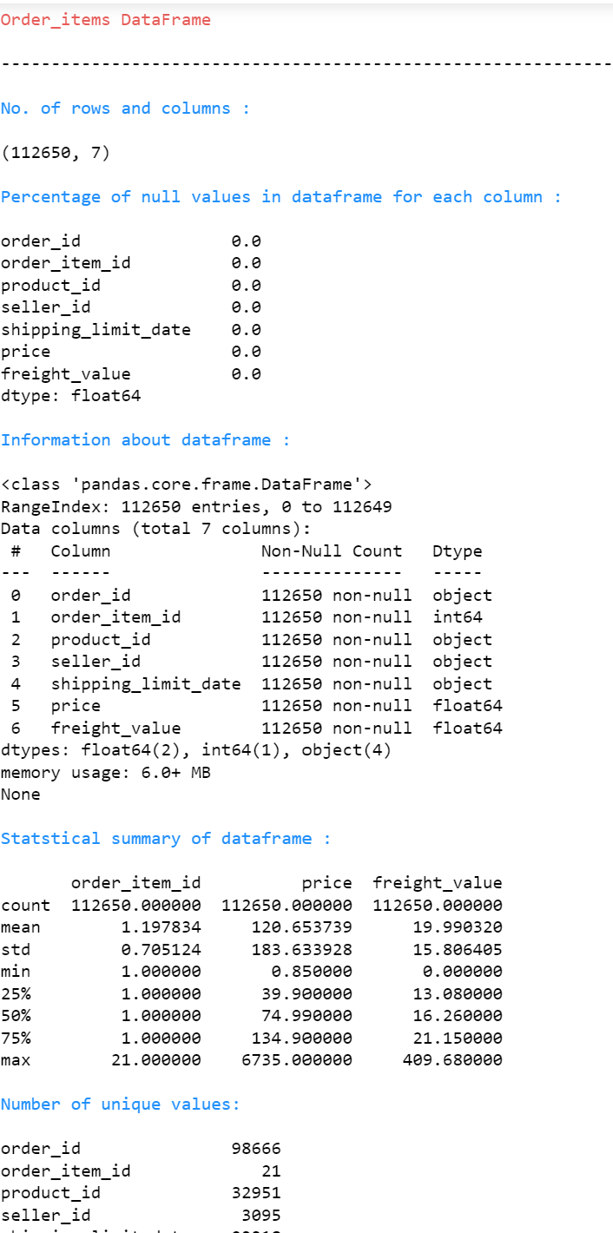
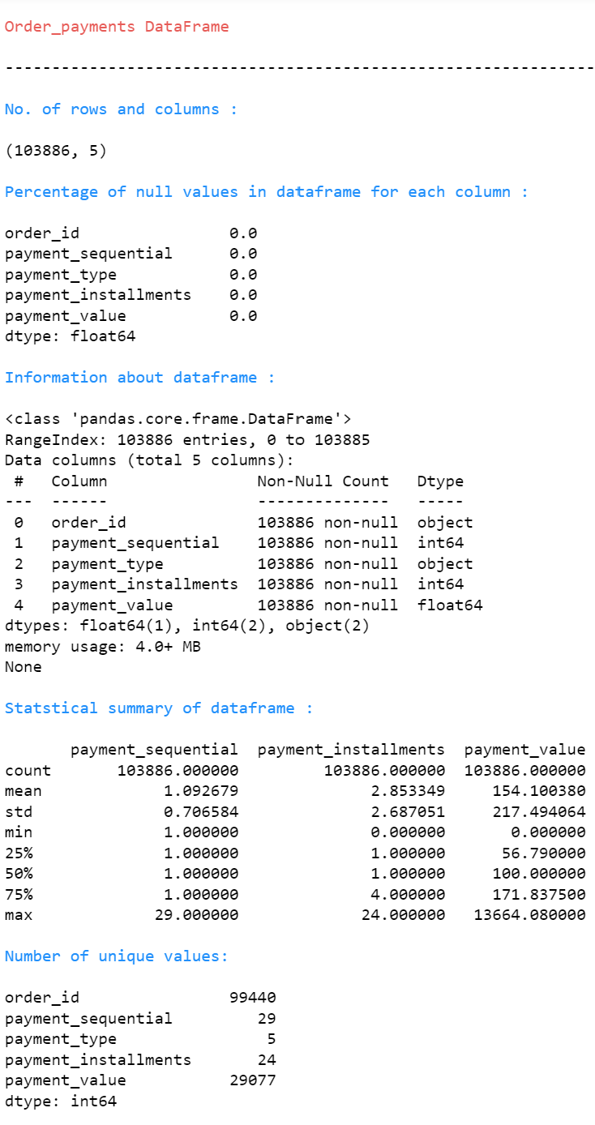
Governance Model

Slide 22
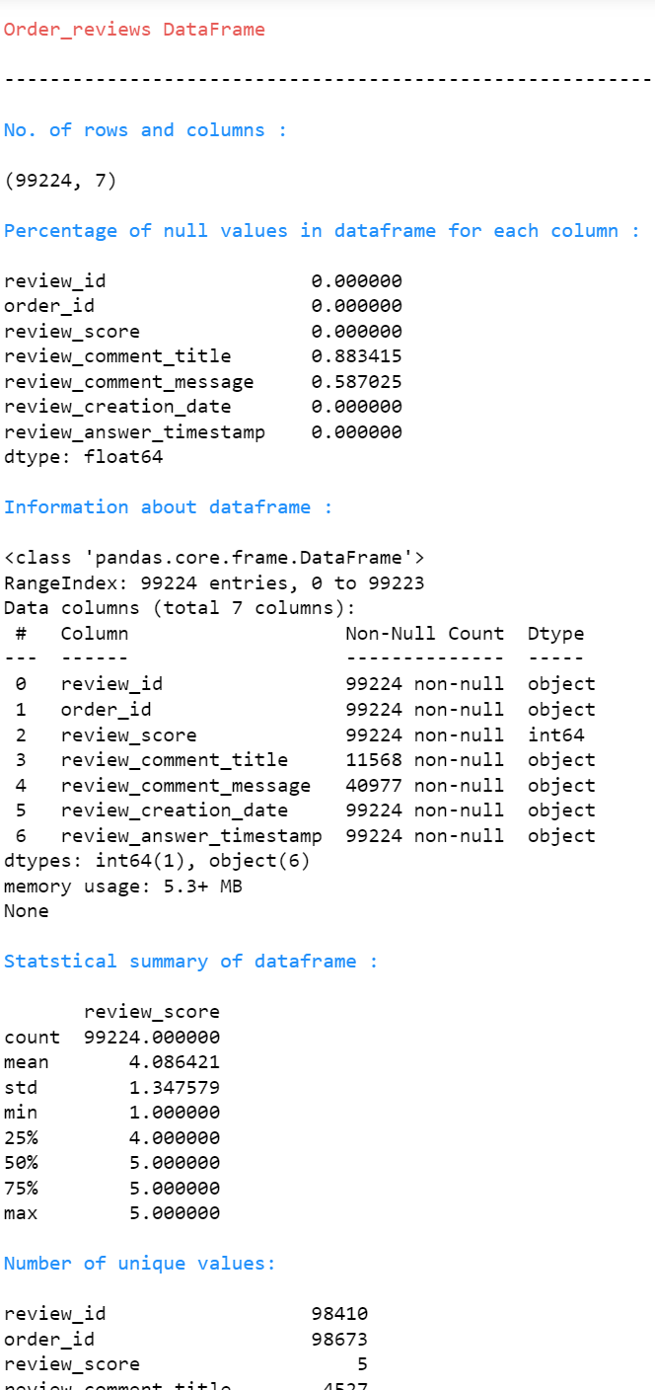
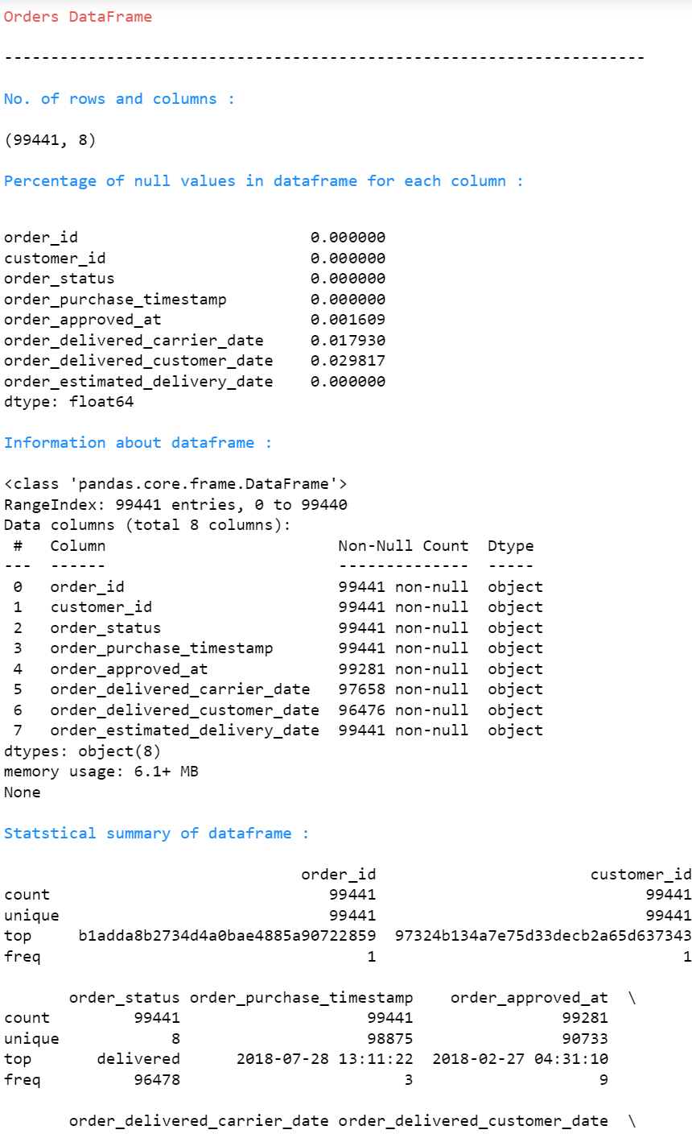
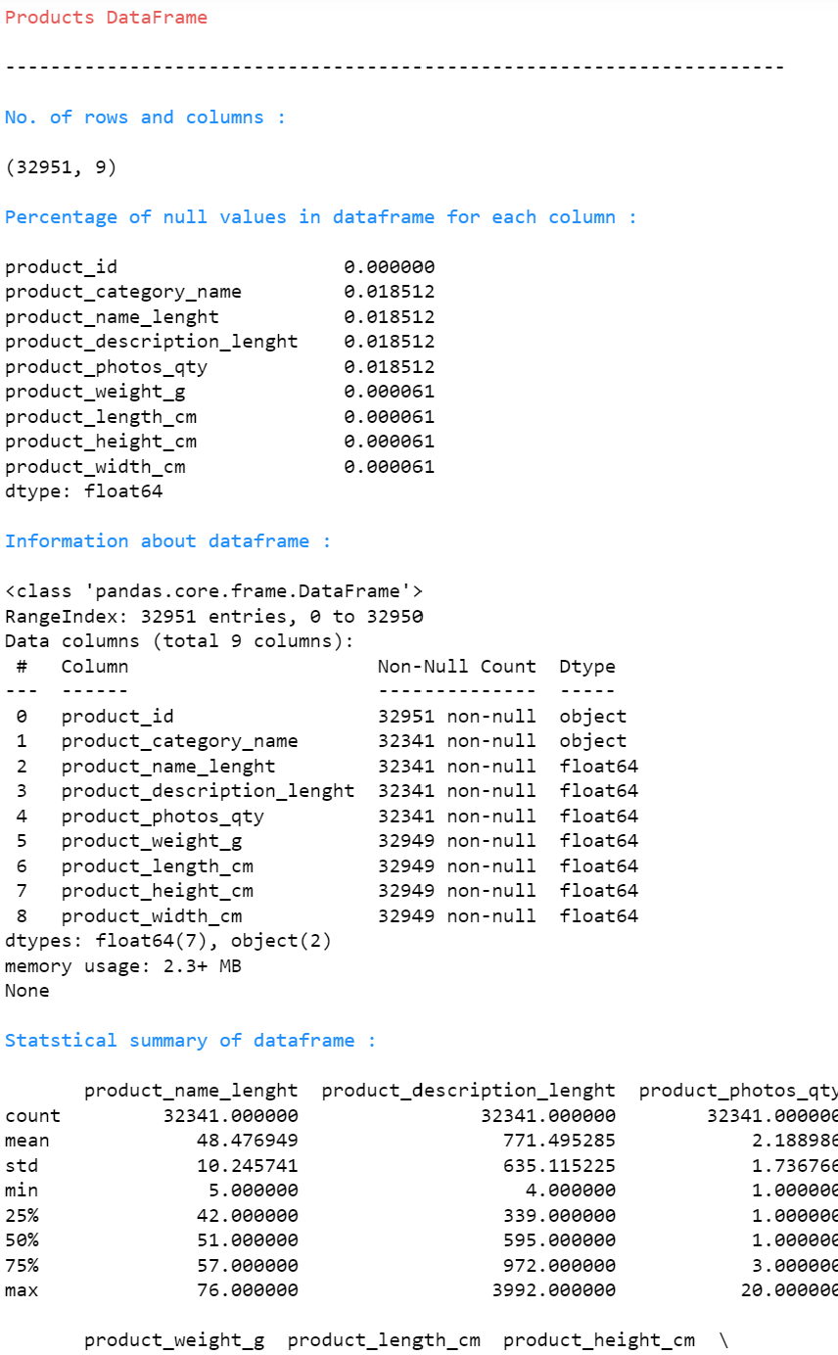
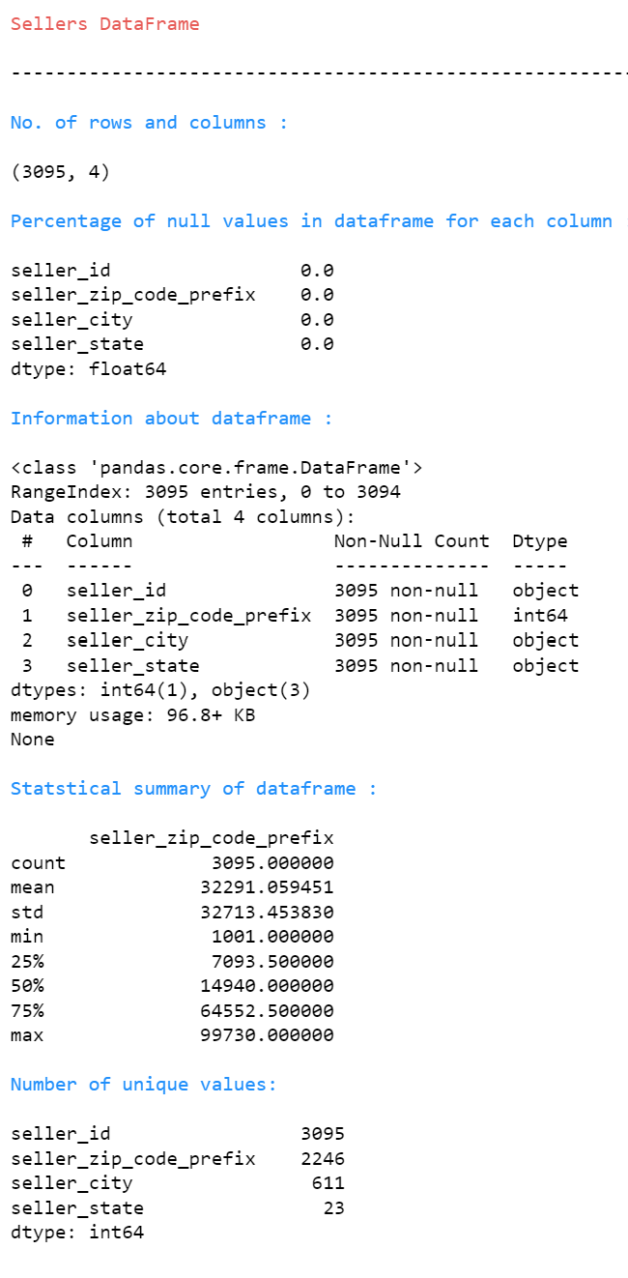
Governance Model …. CONT

Slide 23
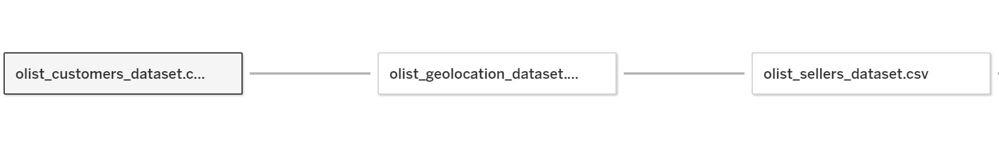
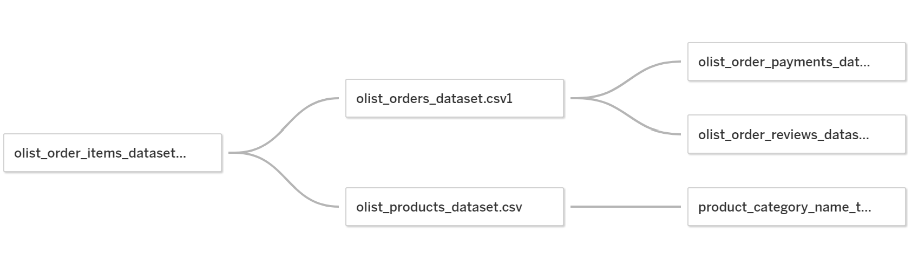
Visualization in Tableau

Slide 24
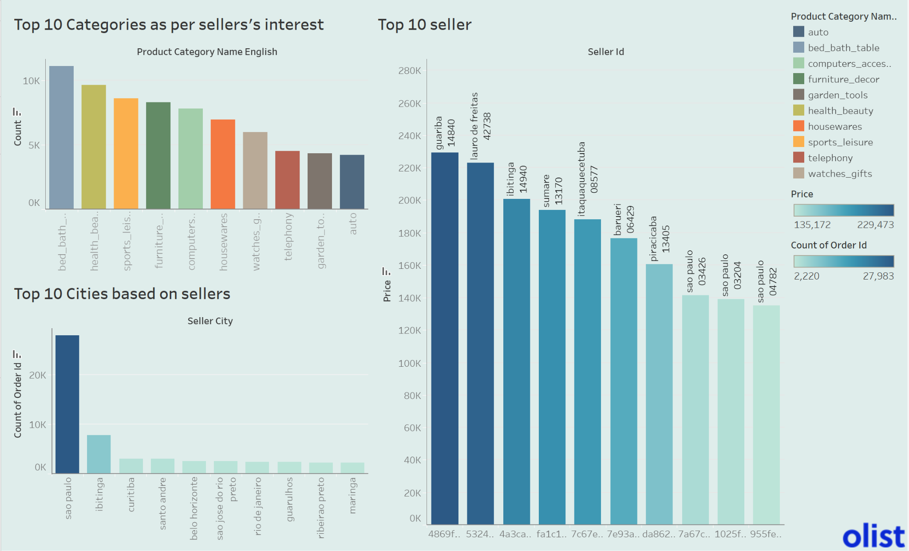
Future:
Marketing analytics for sellers.
Product category for sellers (for supply chain).

Slide 25
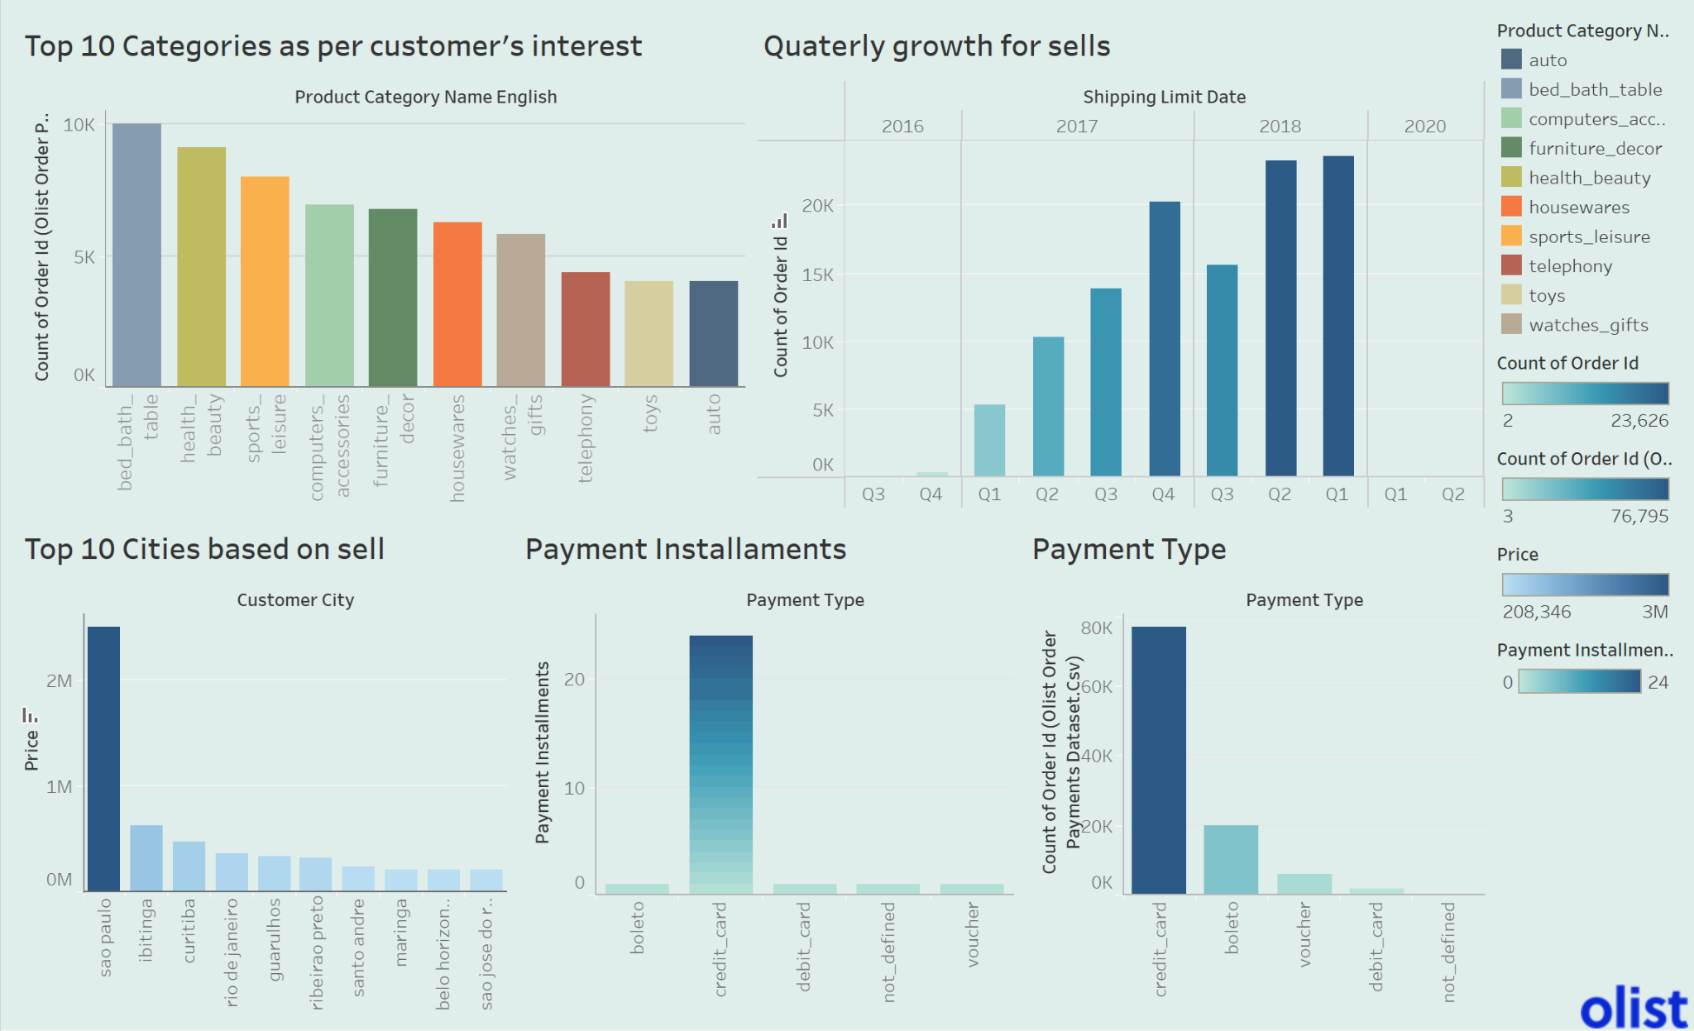
Future:
Scope of revenue growth
Revenue model improvement ex: With advertisement, coupons

Slide 26
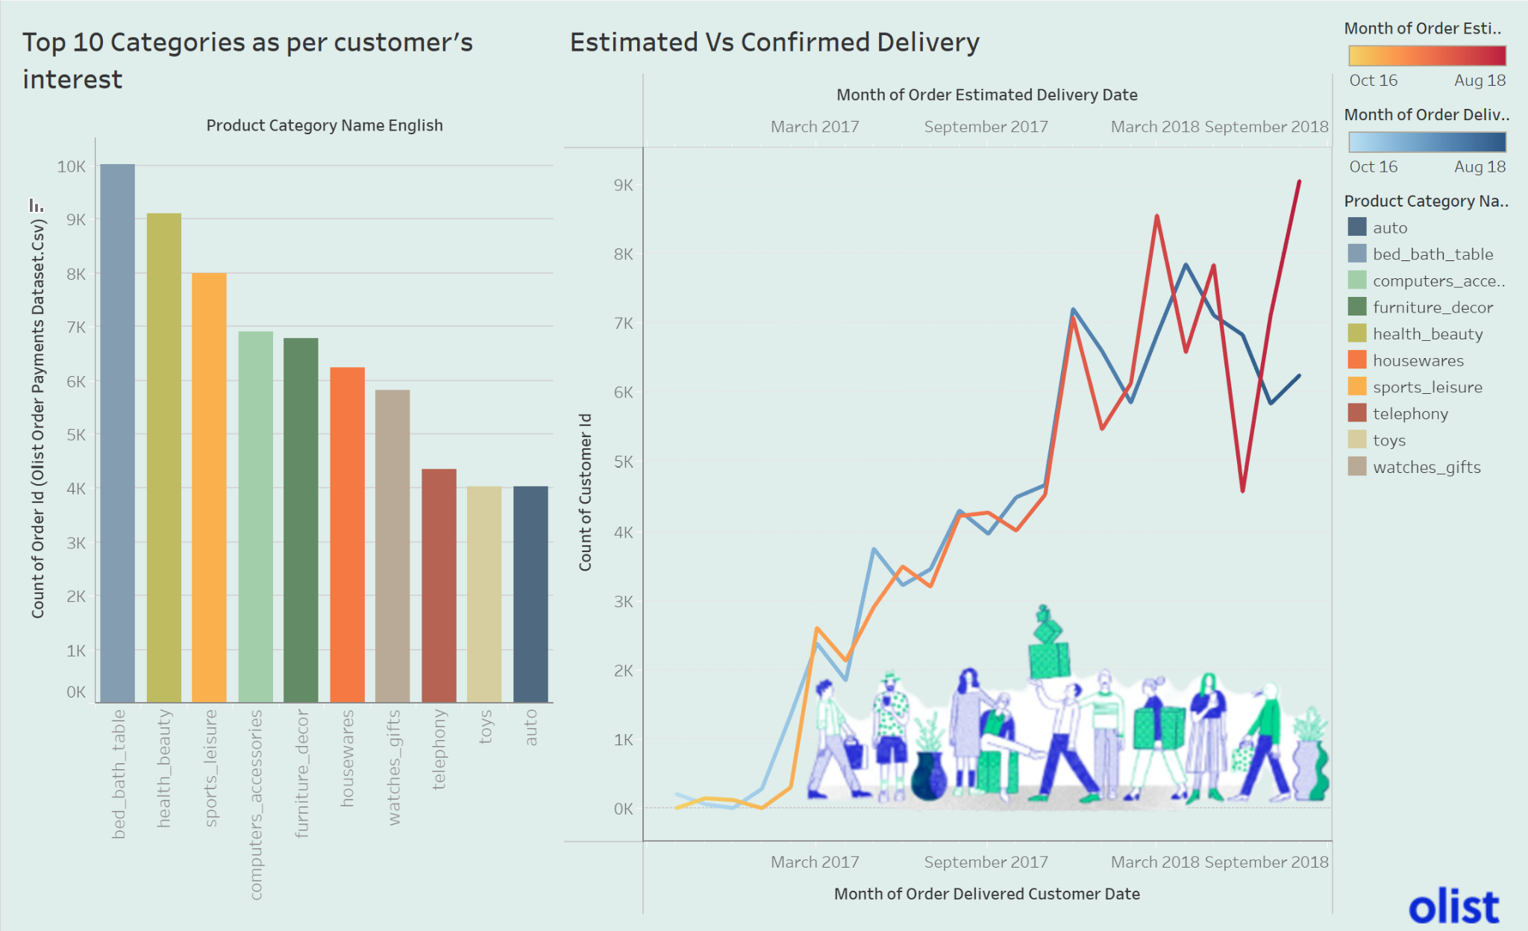
Future:
Model for estimating delivery based on multiple factors. Ex: workforce, climate, product demand, type of the product.

Slide 27
Challenges
Lack of proper information about the company's present data driven stance.
It was pretty challenging to gather a complete company profile and competitors due to its foreign origin and its startup status.
Unable to gather necessary information about the company due to the language barrier.
There was no financial information available to access their financial stance except the amount of capital they are raising in different rounds.

Slide 28
Lesson Learned and Improvement
If Olist could have an interface for translation then non-native people would be able to interact with the product better.
Establish a single standard report system based on data quality metrics and coding
The value of focusing on individual personas while developing our data driven process.

Slide 29
Thanks!
ANY QUESTIONS?

